Slide 1
The Origin of Carbon Enhanced Metal-Poor (CEMP) Stars and
Formation History of Stars and Binaries in the Galactic Halo
「銀河系ハローの炭素過剰超金属欠乏星の起源と星・連星系形成史」
藤本正行 (Fujimoto, M.Y.) (北海学園、北海道大学）
山田 志真子 (Yamada, S.)（北海道大学）
須田拓馬 (Suda, T.)、小宮悠 (Komiya, U.)（東京大学）
町田正博 (Machida, M.N.)（九州大学）

Slide 2
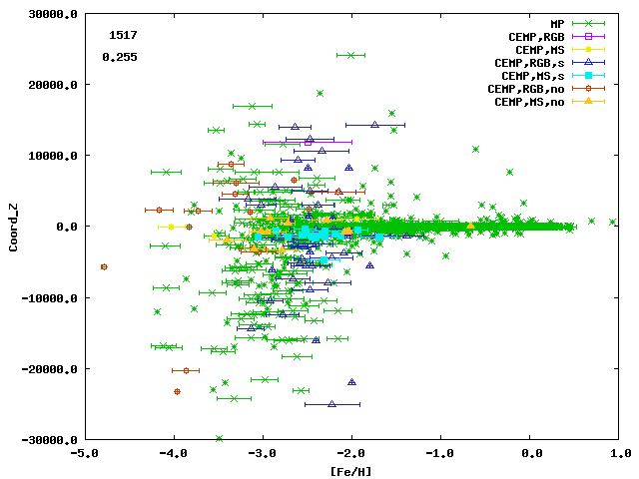
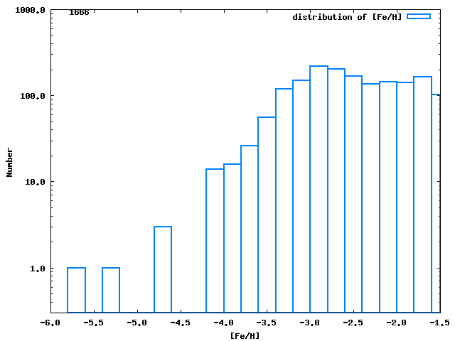
Galactic Archeology
(銀河考古学)
Search for the formation history of Galaxy through the analyses of extremely-metal poor stars in the Galactic halo
Spatial distribution
Metallicity distribution
[Fe/H]<-2.5:682
[Fe/H]<-3: 348
[Fe/H]<-4: 18
Distance from the Galactic plane (pc)
Number
SAGA database
www.sagadatabase.jp
(Suda et al. 2008, 2011)
[Fe/H]
=log(N_{Fe}/N_{H}) - log(N_{Fe}/N_{H})☉
[Fe/H]

Slide 3
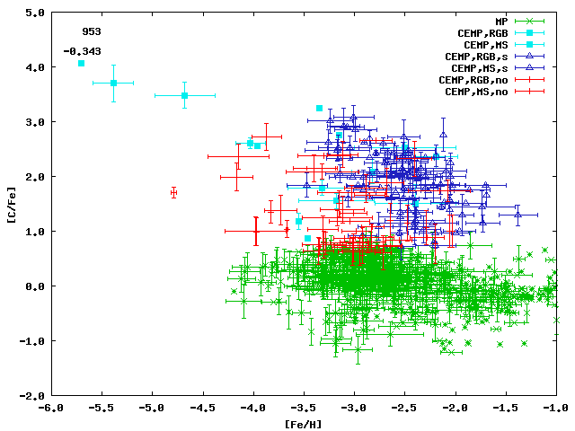
Carbon Enhanced Metal-Poor (CEMP) stars
(Rossi+1999)
CEMP stars: [C/Fe]>0.7
CEMP stars account for a large portion of EMP stars
Fraction of CEMP stars
163/544 = 30% : Fe/H]<-2
57/211 = 27% : Fe/H]<-3
9/15 = 60%: Fe/H]<-4
SAGA database (Suda et al. 2008)
[C/Fe]
[Fe/H]
Notes:
左図：C:\work\0806-\theme\r-process\platex\theme_explain\APJLETTER_NO5nonfirst_s-process\1_Calculation\3_Calc_s-code_libra\JOBS\0_Plot_BaFe_vs_FeH\images_lates_20150308\images_BaFeg
右図：

Slide 4
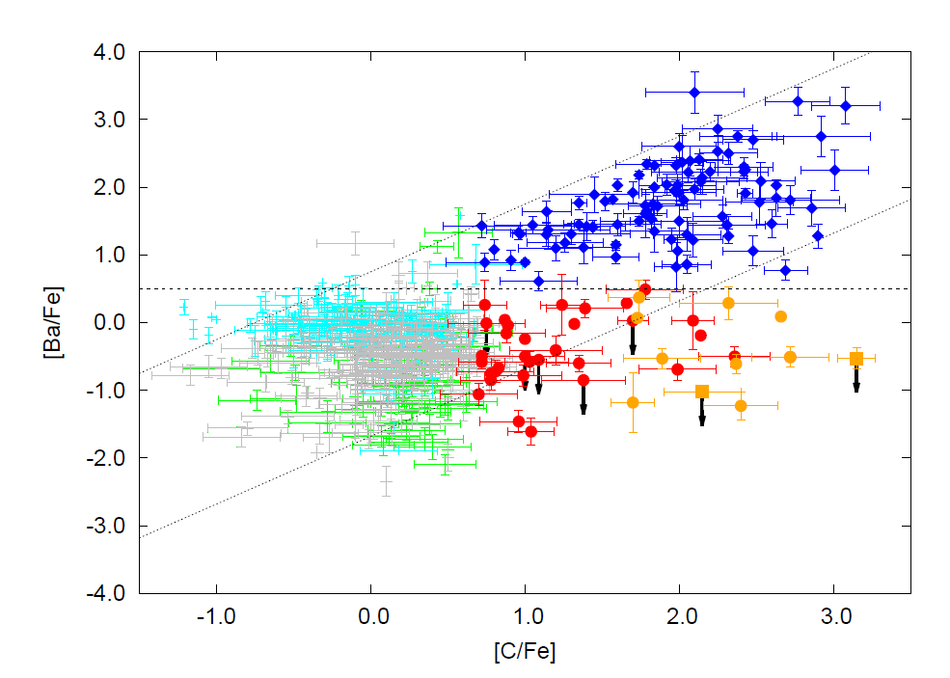
Variations of Neutron Capture Elements
Aoki, Norris + 2002, Aoki, Beers + 2007
CEMP stars: [C/Fe]>0.7
[C/Fe]>0.7
Classification by
Ba enrichment
(1) CEMP-s: [Ba/Fe] > 0.5
  Ba enhancement ⇒ accretion of s-process yields from AGB stars
(2) CEMP-no: [Ba/Fe]<0.5
  Ba not enhanced ⇒ r-process yields or s-process yields
CEMP-s(96)
CEMP-no(51)
Lo-CEMP-no
CEMP stars: [C/Fe]>0.7
account for ≳20% of EMP’s
[Ba/C] = const. during the mass transfer in the binaries
⇓
[C/Fe]∝[Ba/Fe] ∝ accreted mass
[Ba/Fe]
EMP
blue: -2.5 <[Fe/H]<-2
gray: -3<[Fe/H]<-2.5
green:[Fe/H]<-3
[C/Fe]
Notes:
左図：C:\work\0806-\theme\r-process\platex\theme_explain\APJLETTER_NO5nonfirst_s-process\1_Calculation\3_Calc_s-code_libra\JOBS\0_Plot_BaFe_vs_FeH\images_lates_20150308\images_BaFeg
右図：

Slide 5
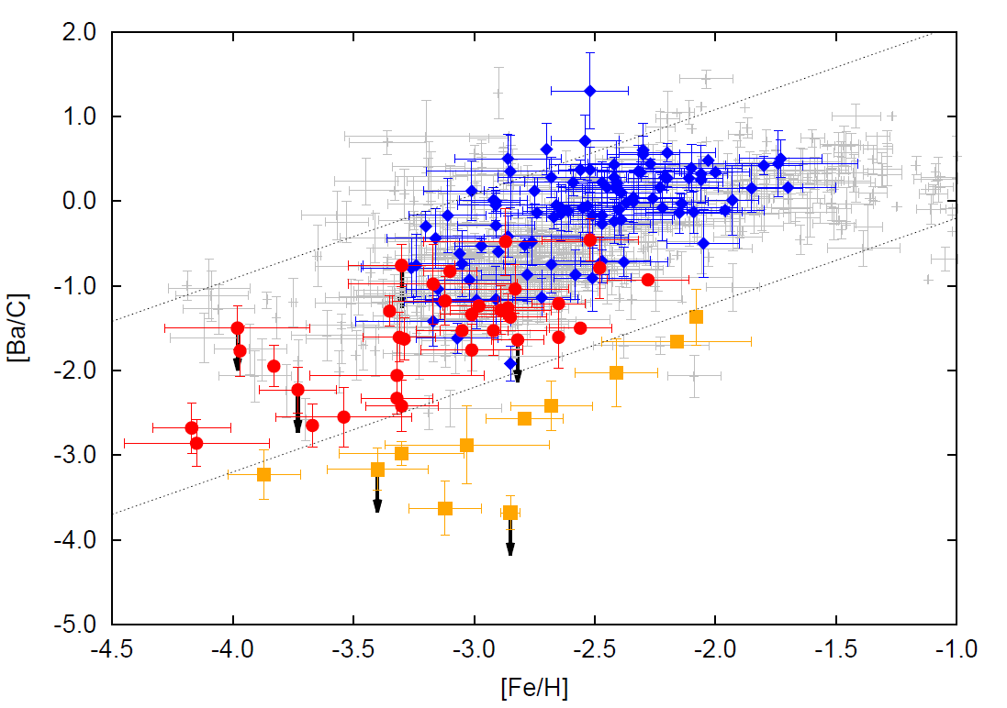
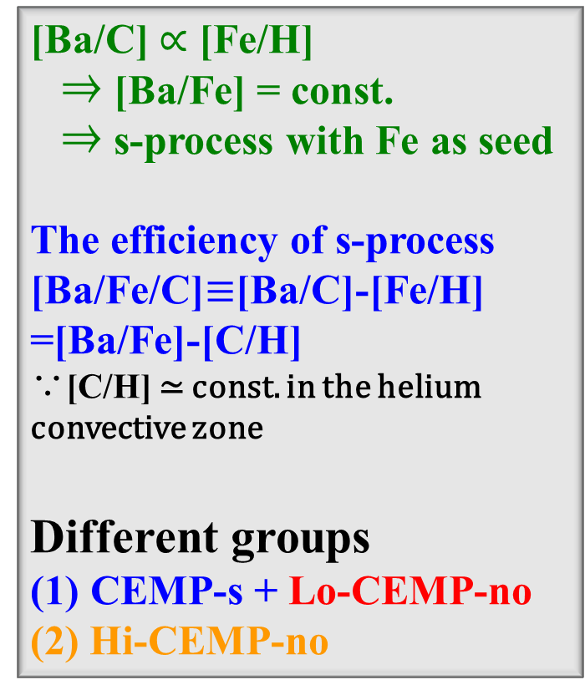
Re-classification of CEMP Stars
[Ba/C] $∝$ [Fe/H]
⇒ [Ba/Fe] = const.
⇒ s-process with Fe as seed
The efficiency of s-process
[Ba/Fe/C]$≡$[Ba/C]-[Fe/H] =[Ba/Fe]-[C/H]
∵[C/H] ≃ const. in the helium convective zone
Different groups
(1) CEMP-s + Lo-CEMP-no
(2) Hi-CEMP-no
[Ba/C]
EMP
[Fe/H]
CEMP-no ⇒ Lo-CEMP-no (40)
Hi-CEMP-no (11)
Notes:
左図：C:\work\0806-\theme\r-process\platex\theme_explain\APJLETTER_NO5nonfirst_s-process\1_Calculation\3_Calc_s-code_libra\JOBS\0_Plot_BaFe_vs_FeH\images_lates_20150308\images_BaFeg
右図：

Slide 6
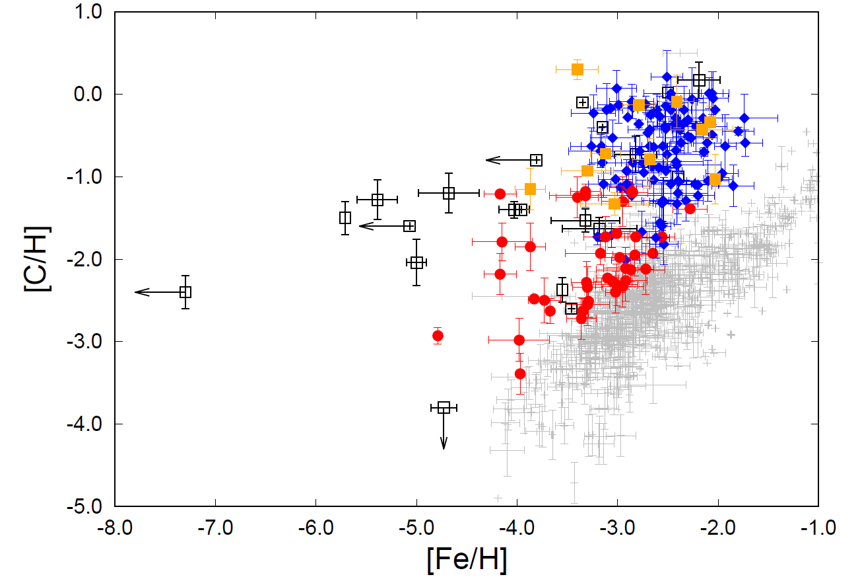
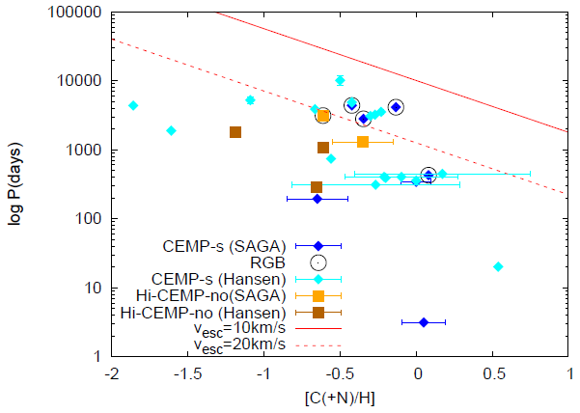
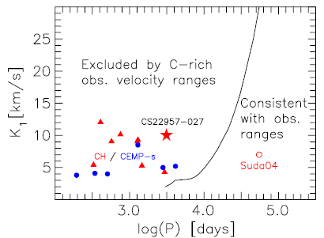
Revisit: CEMP-s vs. CEMP-no
Norris+ 2013, etc.
I. Metallicity dependence:
  CEMP-s stars:
  only for [Fe/H] > -3.4
  Lo-CEMP-no stars:
  [Fe/H]~ -5 ~ -2
II. 連星系:
CEMP-s, Hi-CEMP-no: periods observed (P<10⁴ days)
Lo-CEMP-no stars: binarity not detected → P >10⁴ days
binarity observed
Carbon abundance vs. Metallicity
III. Carbon abundance
CEMP-s: large [C/H]
Hi-CEMP-no: large [C/H]
Lo-CEMP-no: small [C/H]
HE0107-5240
CEMP-no

Slide 7
Binary Origin of CEMP stars
Suda et al. (2004), Komiya et al. (2007)
Surface Pollution: mass transfer from AGB primary to low-mass secondary
Produce and eject both carbon and s-process neutron capture elements
CEMP star
Accretion from the wind
Dredge-up
H
WIND
mass loss
C,O
He
H
Low-mass EMP survivors (M~0.8M◉) :
Primary AGB stars
  (0.8M◉<M ≲8M◉)
AGB stars = C and s-process elements enhancement by the He shell flashes and the dredge-up
CEMP stars : formed via mass transfer from AGB primary:
analogous to CH stars (Pop. II) and Ba stars (Pop. I)
Notes:
And binary scenario has been proposed for the origins of CEMP-s and CEMP-no stars.
Carbon and s-process elements are synthesized in the He shell flash and dredge-up to the surface in AGB stars.
The dredged up materials are accreted on to low-mass secondary star by wind mass loss in binary system.
If primary mass is 0.8-3.5Mo, the dredged up materials are enriched by s-process elements, so after the secondary accreting the material
It turn to be CEMP-s stars, while if primary mass is >3.5 Mo, the dredged up materials are not enriched by s-process elements,
So after the accretion, the secondary turn to be CEMP-no stars.

Slide 8
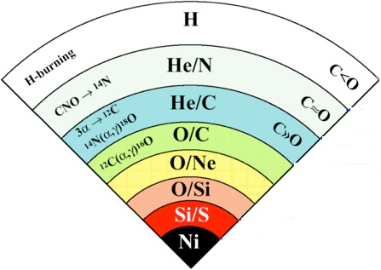
Massive Star Scenarios
1. Faint SNe
2. Spinstars
C-rich ejecta
Rotaitnal mixing
⇓
Low-mass stars formed through mixing with
interstellar gas
⇓
Low-mass stars
formed in circumstellar disk ejected from the equator
Mixing
Fall Back
○ Take out the nuclear products of helium burning
× Lack of neutron capture elements

Slide 9
1. Synthesis of Neutron Capture Elements

Slide 10
r-process and s-process
H
Rapid neutron capture process (r-process)
  site(s): neutron star merger +
  origin: interstellar gas with the chemical evolution
Slow neutron capture process (s-process)
  Independence of metallicity for [Fe/H] ≲ -2
  ⇒ we can deal with all the CEMP stars together
  Site: AGB stars + mass transfer
  1. Convective ¹³C-burning: ¹³C(α,n)¹⁶O
    Low-mass AGB stars (M≲3.5M⊙ ) :
    high efficiency [Ba/Fe/C] ≃ 0.8~3.1
  2. Convective ²²Ne burning: ²²Ne(α,n)²⁵Mg
    Massive AGB stars (M ≳ 3.5M⊙ ) :
    low efficiency [Ba/Fe/C] < 0.8
    Low-metallicity ([Fe/H] ≲-2.5)
Notes:
We employ three neutron sources and mixing mechanisms in AGB stars.
The first is HeFDDM model, in this case neutron reaction is 13C alpha n,
and this mechanism works at low mass AGB stars and low metallicity,
The second mechanism is 22Ne burning + TDU. These are He flash induced convections, and
Nitrogen of Hydrogen burning ashes is involved in the convection and 22Ne is synthesize through
This reaction. And neutron reaction is 22Ne alpha n
The third is 13C pocket + TDU. Injection of hydrogen from surface in He zone, make 13C pocket in this thin layer, and proton is captured by 12C and 13C is formed, and neutron reaction is this.

Slide 11
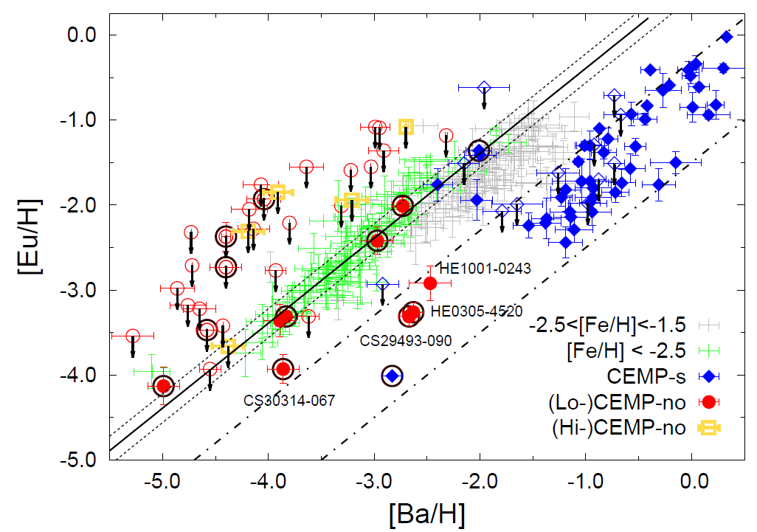
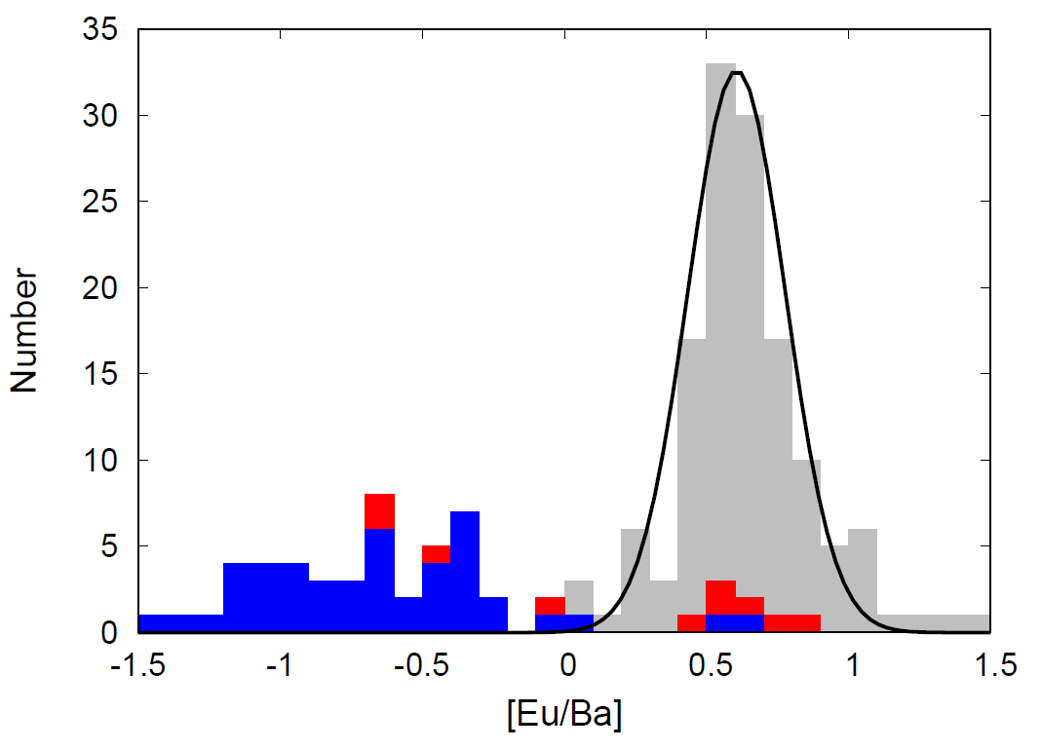
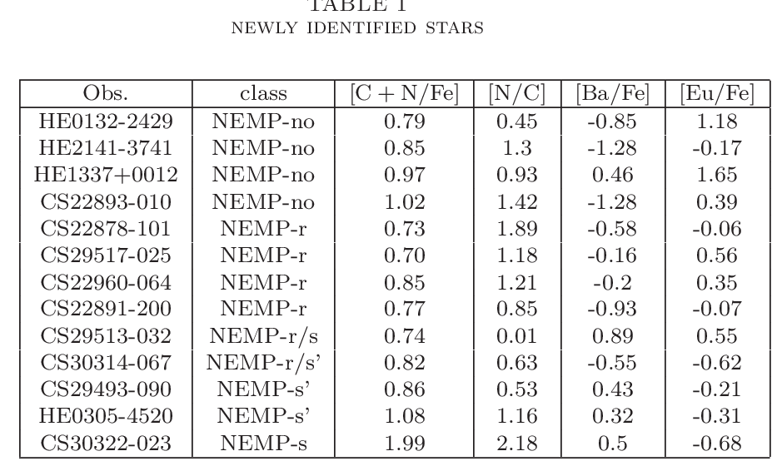
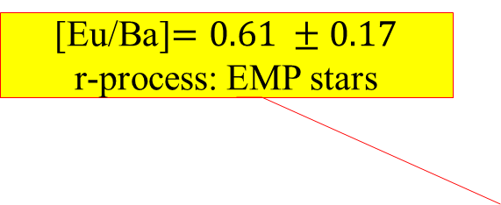
s-process vs. r-process
s-process vs. r-process
r-process vs. s-process
[Eu/Ba]$=0.61 ±0.17$
r-process: EMP stars
[Eu/Ba]=0
10 Lo-CEMP-no stars have Eu abundance measure
殆どの CEMP-no はEuの測定値も持たない
Others with remote upper limit
4 stars with
[Eu/Ba] < 0
➔ contribution of
s-process yields
= same as CEMP-s
Newly identified CEMP stars

Slide 12
2. Origin of CEMP-no Stars

Slide 13

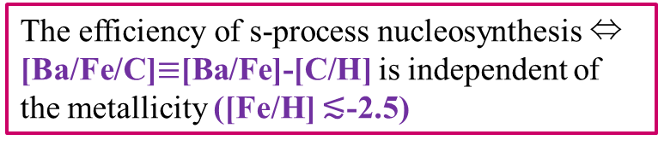
Observed characteristics
The efficiency of s-process nucleosynthesis ⇔ [Ba/Fe/C]$≡$[Ba/Fe]-[C/H] is independent of the metallicity ([Fe/H] ≲-2.5)
EMP星
Characteristics of CEMP stars
A large range of s-process efficiencies
also in the carbon abundances
⇒ bimodal distribution
CEMP-s: large [Ba/Fe/C] >$0.8$⇒ low-mass AGB stars, large [C/H] ≳ 1.5
CEMP-no:
Hi-CEMP-no： low [Ba/Fe/C] <$0.8$⇒ massive AGB stars, large C/H] ] > -1.5
Lo-CEMP-no:
large efficiencies and low C-abundances
  ⇒ mixing between the accreted and pristine matter
Sr: large pristine abundance in comparison with the s-process efficiency
Ba: strong s-process efficiency comparable or lager than the pristine abundances
Mixing track
s-process efficiency
[Ba/Fe]=0.5
EMP星
Carbon abundance [C/H]

Slide 14
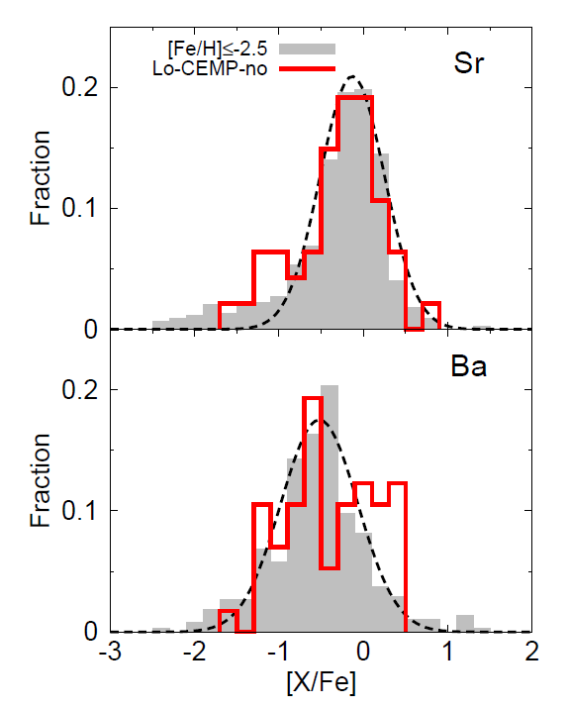
Dominance of s-process
Lo-CEMP stars: different from the composition of C-normal stars (formed of the same gas)
[Ba/Fe]: rather flat distribution with protrusions on both sides
[Sr/Fe] : almost similar distribution to C-normal stars but with a protrusion only on smaller side.
⇒ Carbon enhancement accompanies the s-process yields
⇒ binary origin
Newly identified CEMP stars

Slide 15
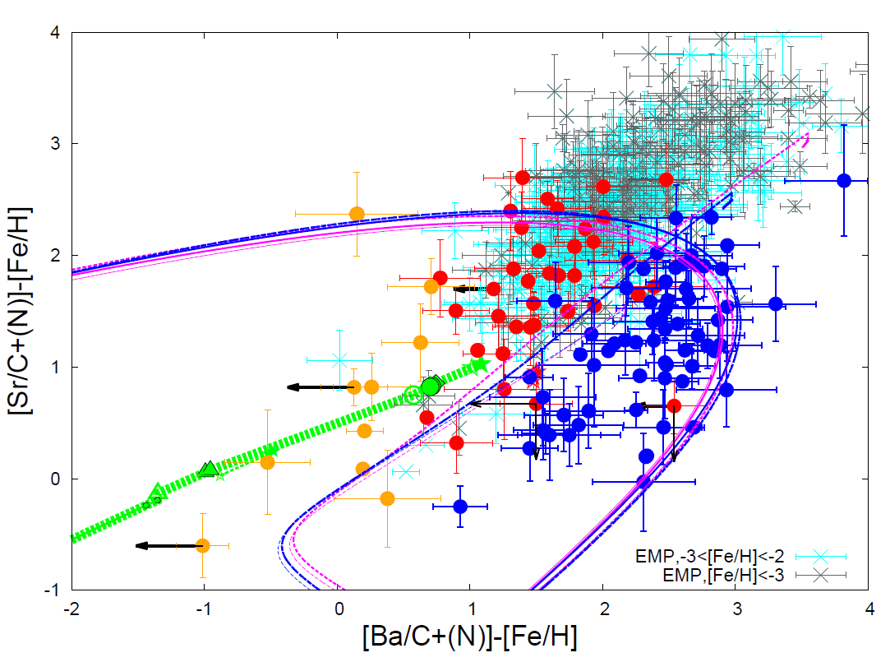

Model vs. observation
$$−4.5<[{Fe}/H]<−2$$
¹³C(α,n)¹⁶O
+ dilution by carbon later dredged up
²²Ne(α,n)²⁵Mg

Slide 16
2. Bi-modal period distribution of mother binaries

Slide 17
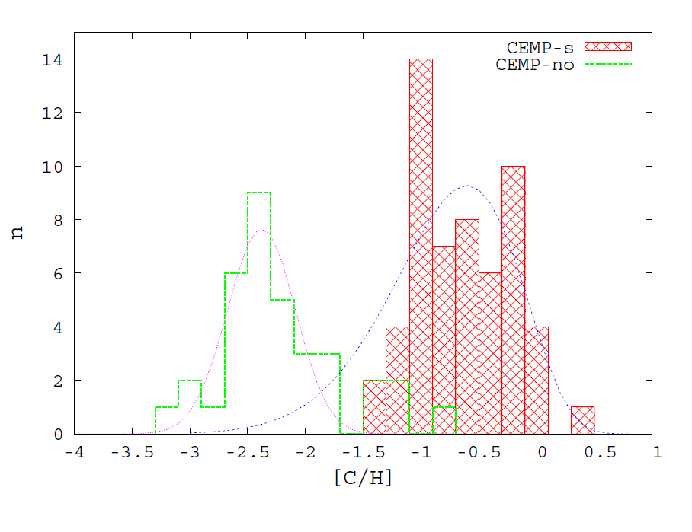
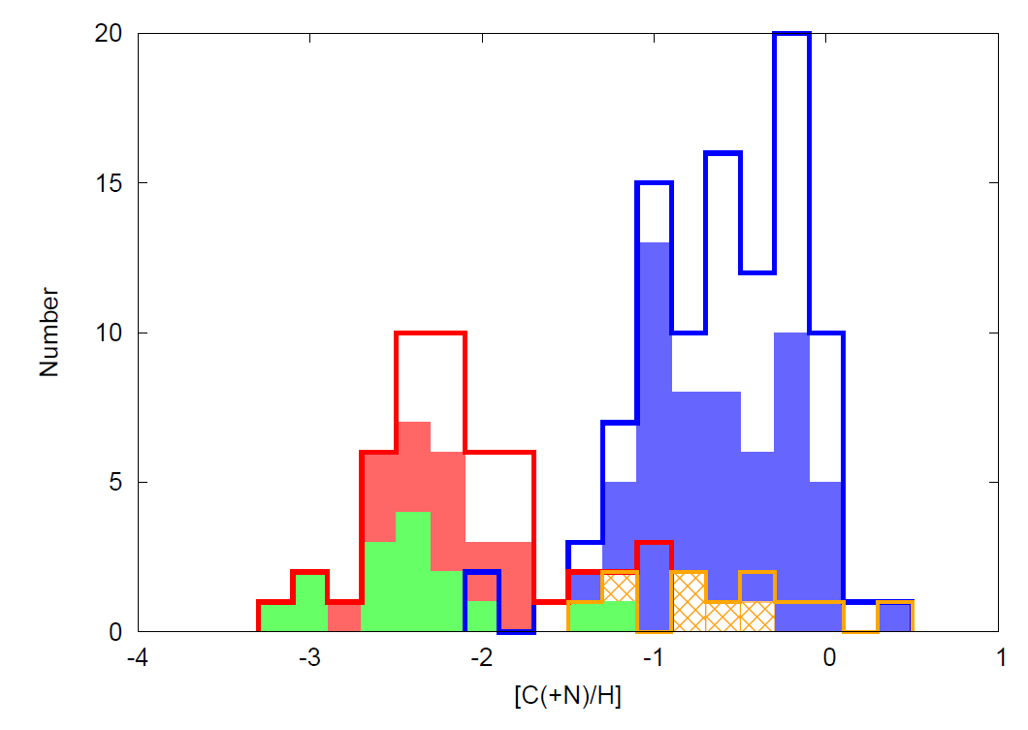
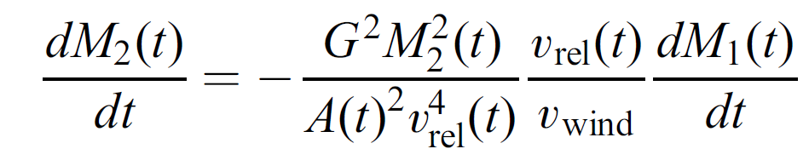
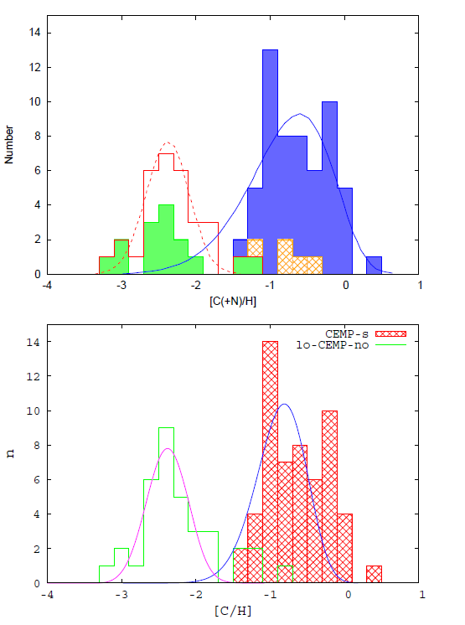
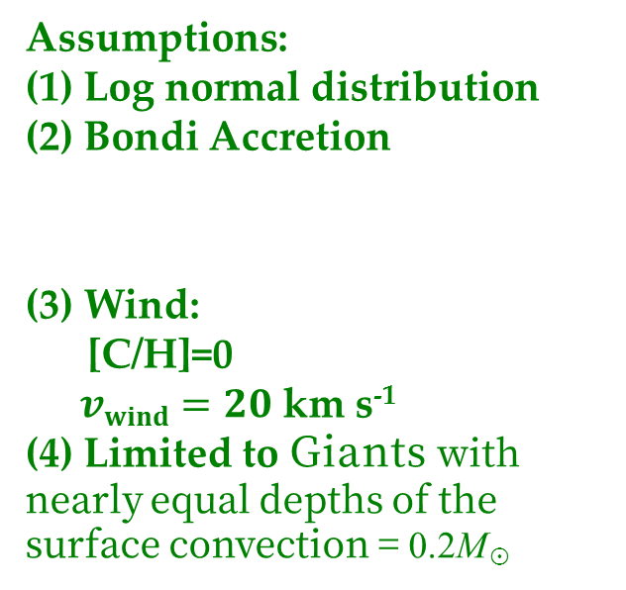
Initial period distributions
Period Distributions
Lo-CEMP-no & CEMP-s : Bi-modal distribution of [C/H]
Bi-modal distribution of binary separation
Assumptions:
(1) Log normal distribution
(2) Bondi Accretion
  (3) Wind:
  [C/H]=0
  $vwind=20$ km s⁻¹
  (4) Limited to Giants with nearly equal depths of the surface convection = 0.2M☉
  ^{Giants}
CEMP-s
Lo-CEMP-no
[C/H]

Slide 18
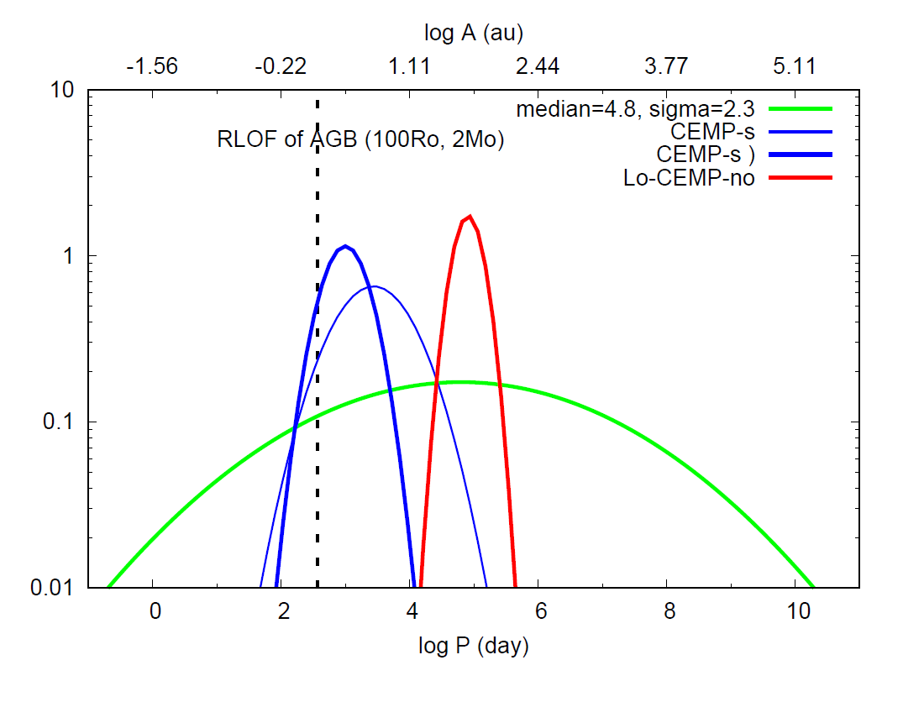
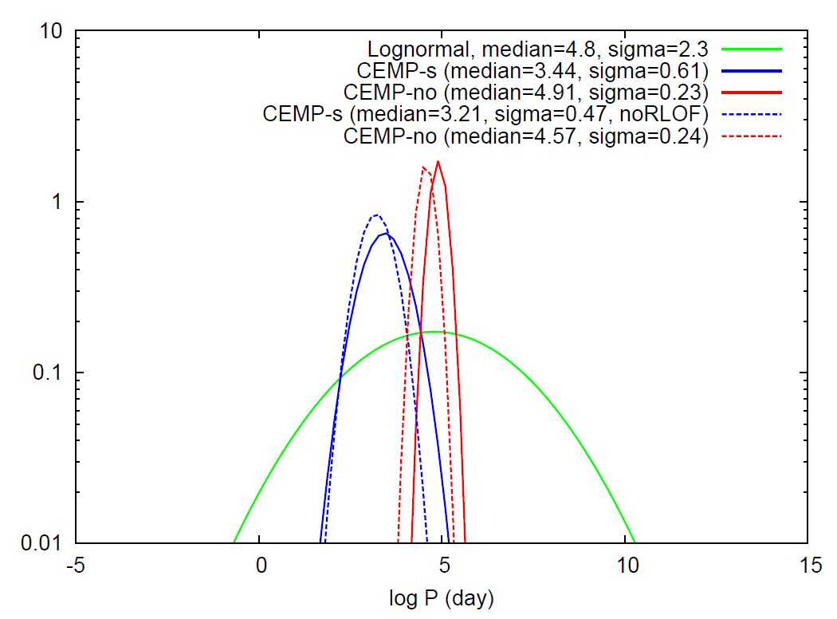
Bi-modal distributions of mother binaries
Orbital period
CEMP-s:
Log P = 3.44 (3.0)
 0.61 (0.35)
Lo-CEMP-no:
Log P = 4.91 0.23
  Both [Fe/H] > -3.4 and <-3.4
Short period binary
Long period binary
  Roche
  lobe overflow
Smaller carbon accreted
⇒[C/Fe]<0.7
Cf. Solar neighborhood (Duquennoy & Mayer 1991)

Slide 19
3. Formation history of Binaries in the early universe

Slide 20
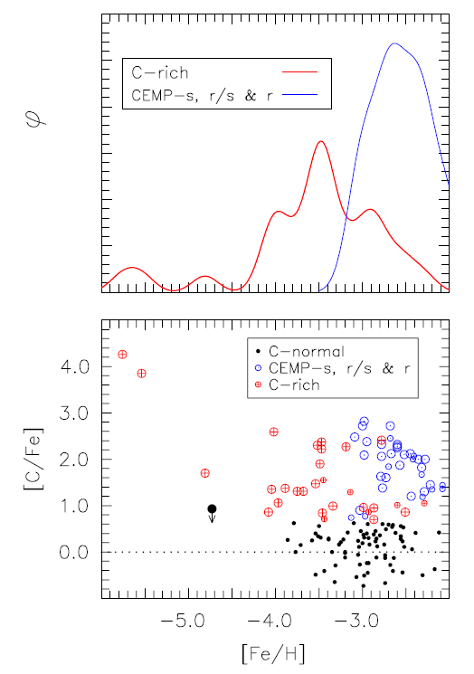
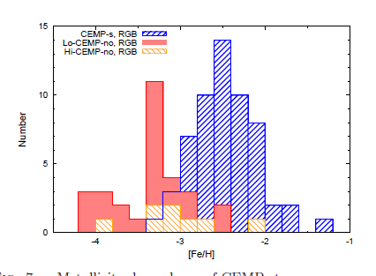
Metallicity distribution of CEMP stars
CEMP-s: observed only for [Fe/H]>-3.4
⇒ no short-period binaries (P < 10⁴d) for [Fe/H]<-3.3
since the s-process is independent of the metallicity
Lo-CEMP-s: observed from [Fe/H] ≈ -5 (limit of Ba detection) to[Fe/H] ≈ -2 (limit of CEMP star)
⇒ long-period binaries (P > 10⁴d) regardless the metallicity
CEMP-s
frequency
CEMP-no
Norris et al. 2013
CEMP-no
CEMP-s

Slide 21
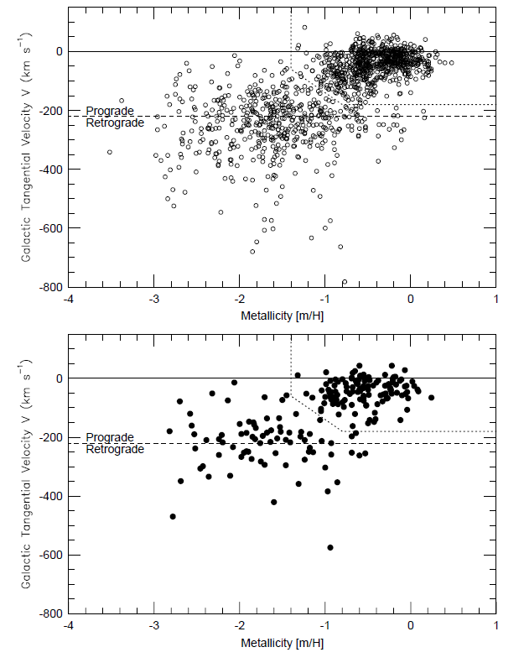
Formation
History of Binary
Period distribution
metallicity
連星形成の金属量依存
Long period binaries formed
Long and short period binaries
[Fe/H] >-3: No obvious change between the Halo &Disk stars (Lathan + 2002) , but for short period binaries
Binary Fraction
Disk stars
[Fe/H]≈ -3.4:
Halo stars
Single stars
:
Spectroscopic binaries

Slide 22
4. Pathways to low-mass binary formation (with the primaries of AGB stars)

Slide 23
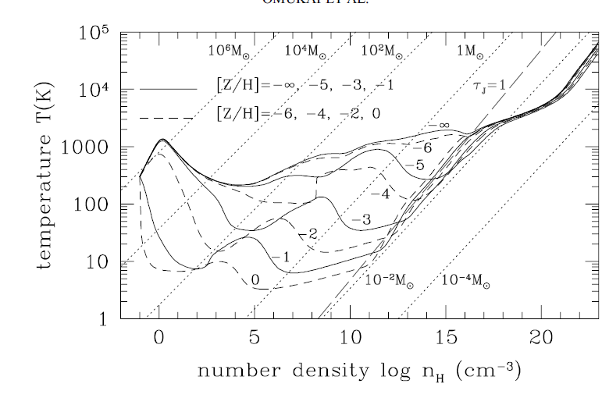
Formation mechanism of binaries
large-scale fragmentation of turbulent gas cores and filaments (wide binaries)
smaller-scale fragmentation of a protostellar disk due to gravitational instability
    the first core (short period binaries)
    the second core (close binaries)
Metallicity dependence
⇒ formation of the first core
for larger metallicity
Machida et al. (2010)
Second
core
First core
Omukai + (2005)

Slide 24
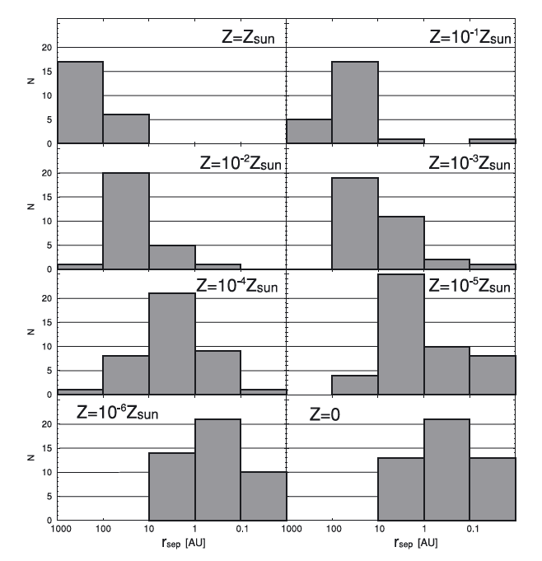
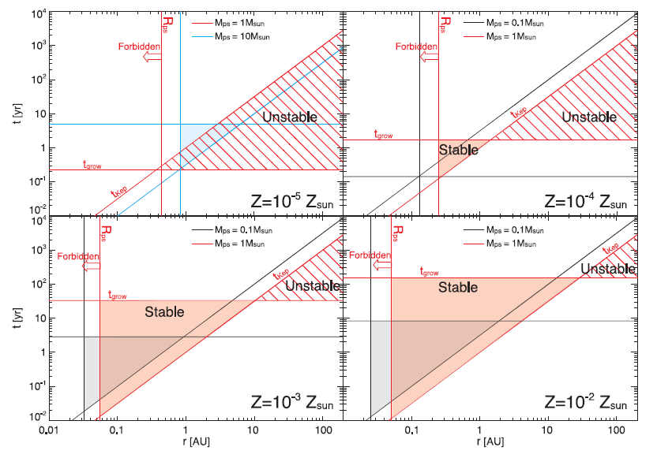
Mass & Circumstellar disk of Protostars
Binary separation increases with the metallicity: close binary → short period binary at [Fe/H] ≳ -3
Mass of protostar is likely to differ between [Fe/H] = -4 and -3.
Massive stars
Low-mass
AGB stars
Machida et al. (2009)
Machida & Nakamura (2015)

Slide 25
Summary
Variations in the C-abundance and N-capture elements observed from CEMP stars explicable in terms of the mass transfer from AGB stars in the binaries
Large variations in the efficiency of s-process nucleosynthesis by more than four orders of magnitude in EMP, AGB stars
  Convective ¹³C burning in low-mass AGB stars (M ≲ 3.5 M☉)
  Convective ²²Ne burning: in massive AGB stars (M > 3.5 M☉)
Bi-modal distribution of C-abundances ⇒ period distributions of mother binaries (also mass difference in the primary stars)
  CEMP-s stars : short period binaries (P < 10⁴d)
  Lo-CEMP-no stars: long period binaries (P > 10⁴d)
Formation history of binaries in the early Universe, revealed
  Log-period binaries: regardless of metallicity
  Short period binaries: for [Fe/H] ≳ -3.4 ⇒ dust cooling

Slide 26
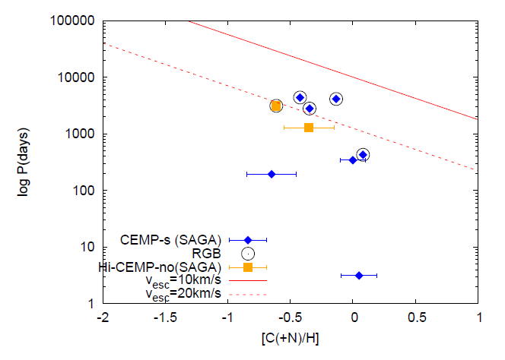



Binary periods before vs. after the mass transfer
Period estimated from accreted carbon abundances
Short period binaries (CEMP-s)
⇓
Interaction of wind and orbital motion → Roche-lobe overflow → contact systems
⇓
Evolution of binaries with the interaction
Giants with 2M☉$,vwind=20$ km s⁻¹
$10$ km s⁻¹
Assumptions:
(1) Log normal distribution
(2) Bondi Accretion
  (3) Wind:
  [C/H]=0
  $vwind=20$ km s⁻¹
  (4) Limited to Giants with nearly equal depths of the surface convection = 0.2M☉

