Slide 1
Origin of CEMP stars
初代星研究会@呉 2018/2/11
小宮 悠（東京大学 RESCEU） Yutaka Komiya (U.Tokyo) .

Slide 2
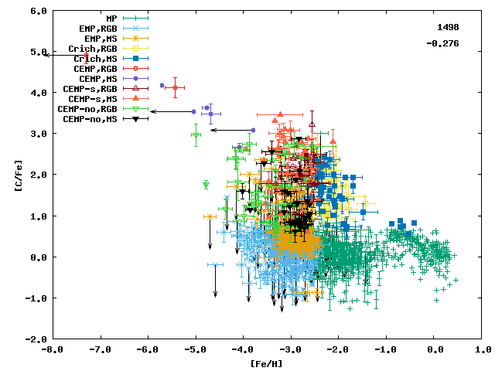
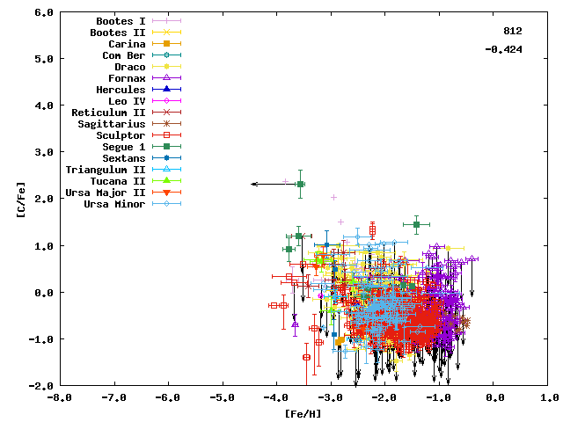
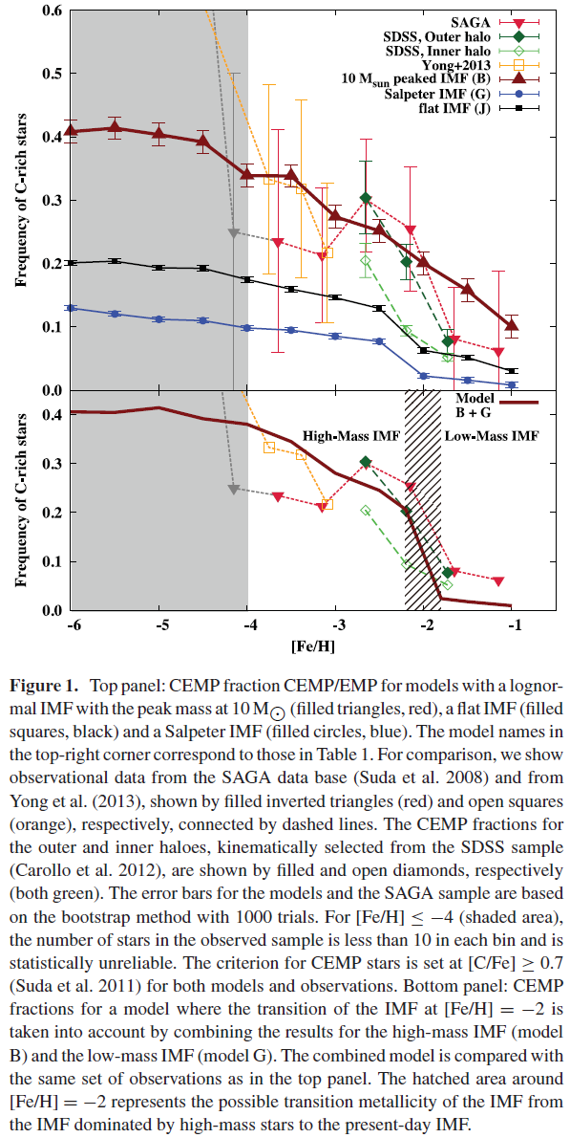
CEMP star
SAGA database
Carbon Enhanced Metal Poor star (Carbon-rich Extremely Metal Poor)
[C/Fe] > 0.7 (Aoki+ 2007)
~20 % of stars with [Fe/H]≲-2 are CEMP stars
UMP star ([Fe/H]<-4) 17~20/27 are CEMP stars
HMP star ([Fe/H]<-5) 5/5 are CEMP stars

Slide 3
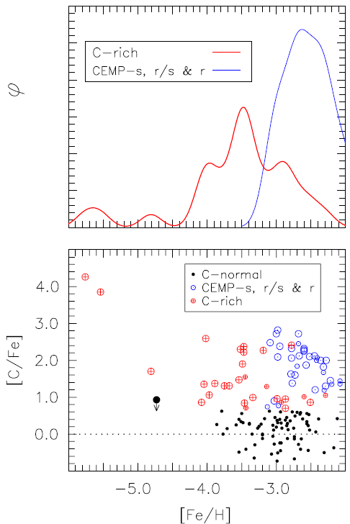
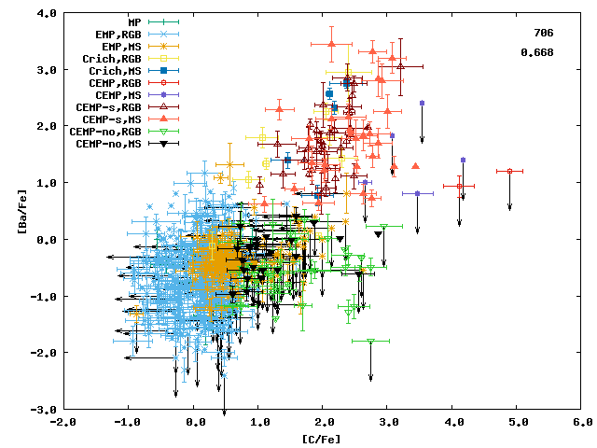
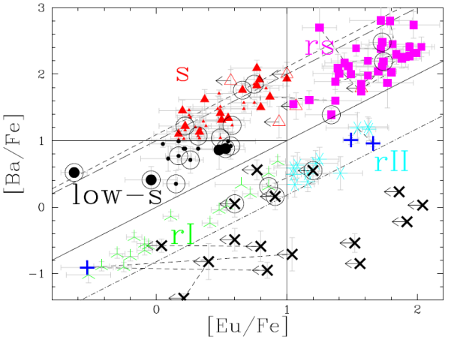
Subclasses of CEMP (I)
Norris+ 2013
S-process elements (Ba)
CEMP-s ([Ba/Fe]>+0.5)
Binary
Mass transfer from intermediate mass companions （CH star ）
CEMP-no
Lower metallicity
Binary fraction is similar to normal stars
Detailed classification
CEMP-r
R-process
CEMP-rs
S-process & r-process
CEMP-low s
[Ba/Fe]<0.5
[Ba/Eu]: s-process like
Masseron+ 2009

Slide 4
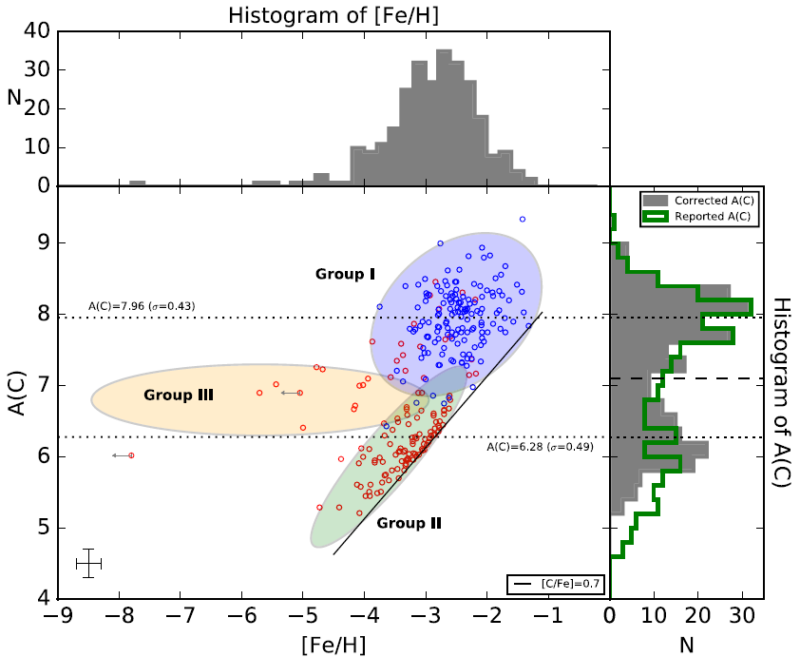
Subclasses of CEMP (II)
Group I
CEMP-s
CEMP-no
Group II
UMP, HMP
Group III
CEMP-no
[C/Fe] ~ 1

Slide 5
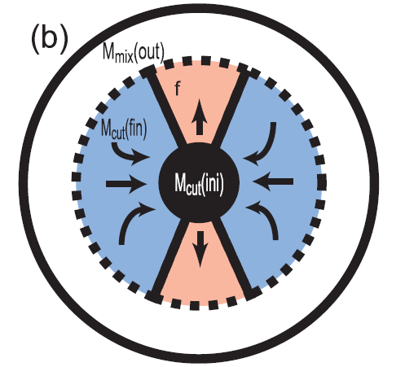
Origin of CEMP-no stars
Intermediate mass stars
H
Binary scenario
Mass transfer from intermediate mass companion stars
(CEMP-s, CH star)
Faint supernova scenario
Supernovae eject carbon-enhanced matter
Mixing fallback
Spinstar scenario
C-rich stellar wind from rotating massive star
CEMP

Slide 6
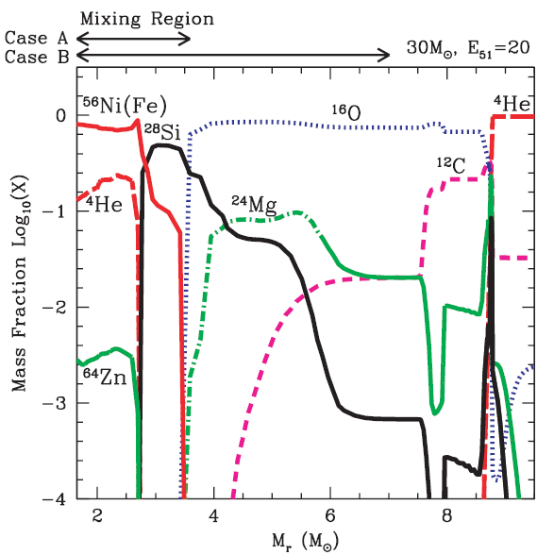
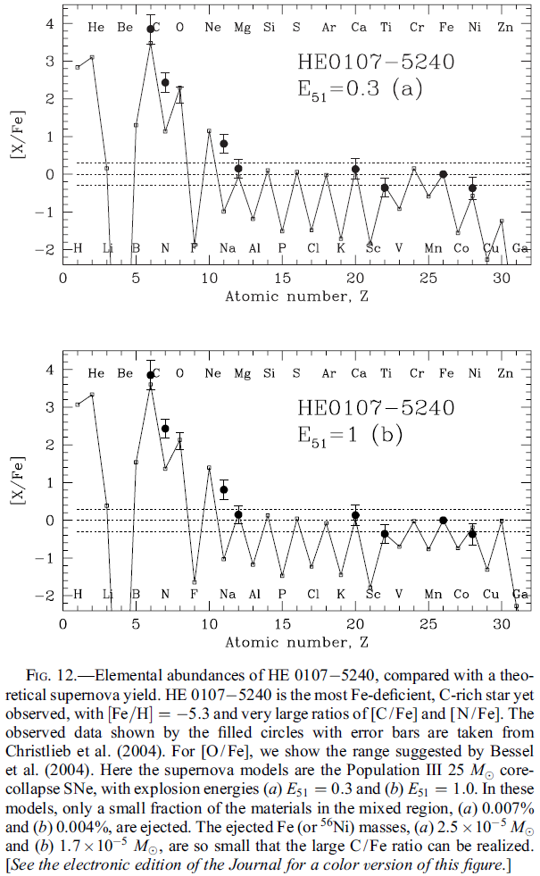
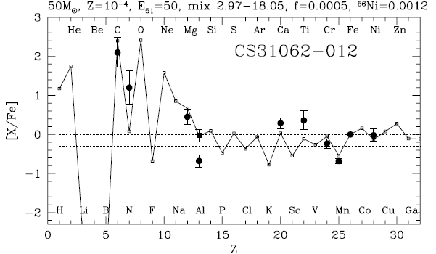
Faint supernova
Mixing fallback model (Umeda & Nomoto 2003, Tominaga+ 2007)
Free parameter
M*, E
M_{mix} , M_{cut} , f

Slide 7
Does the faint supernova model reproduce the observed abundance distribution ?

Slide 8
Chemical evolution model
First star
First supernova
Mini-halo ~10⁶M☉
Milky Way
Proto-galaxy
Merger tree : exteneded Press-Schechter method
Chemical evolution in merger trees
Different chemical abundance between proto-galaxies (Homogeneous chemical abundance inside each proto-galaxy)
Satellites merge to the host galaxy in dynamical friction timescale
Register all the individual EMP stars
SN triggered galactic wind →Metal pre-enrichment of intergalactic medium (IGM)
Surface pollution of Pop III, II stars

Slide 9
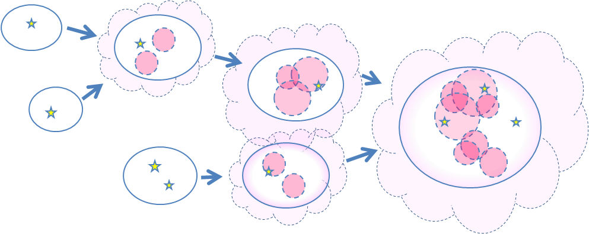
Chemical evolution model
Mini-halo ~10⁶M☉
Inhomogeneous metal enrichment process in mini-halos

Slide 10
Metal mixing
Swept-up mass of SNR
Shigeyama+ (1998)
Diffusion
M_{mix} = C_{diff}t^{3/2} (C_{diff} = 10⁻⁵ yr ^{-3/2} M_{sun} ,(10⁷M_{sun} @ t=10⁸ yr))
Metal abundance
Randomly determine whether a star is in the enriched area or not for each SN (stars randomly move before their explosion)
Homogeneous for halos with Σ(M_{sw}+M_{mix}) > 30 M_{gas}
$$Y_{Fe}=\sum_{i}{\left(\frac{M_{Fe,i}}{{M_{sw, i}+M}_{mix, i}}\right)}{}$$

Slide 11
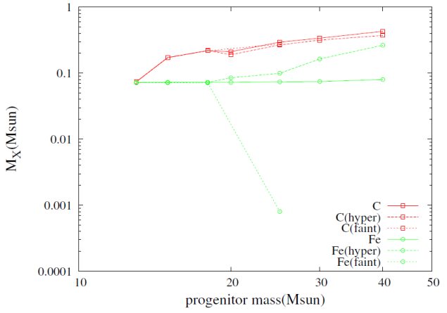
Faint supernova
Supernova yield
Kobayashi+ (2006)
Faint supernova
All stars with Z < Z_{cr} (Z_{cr} = 10⁻⁵, 10⁻⁴, 10⁻³Z_{sun})
Y_{Fe} is reduced by factor f by hand
f = 0.1 ~ 10⁻⁵ flat distribution for log f
Y_{C} : Kobayashi+ (2006)
（distribution of M_{mix} , M_{cut} , f is unknown）

Slide 12
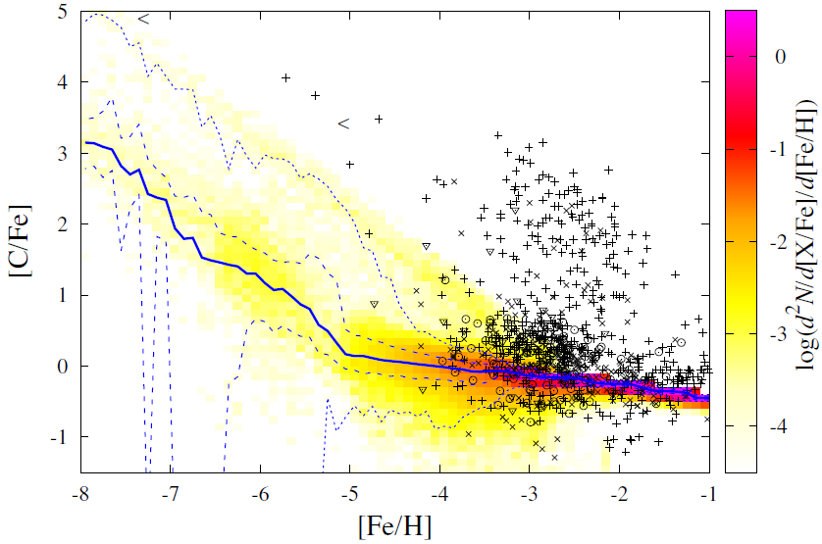
Result
[C/H]=-3
[C/H]=-2
[C/H]=-1
Faint SN Y_{C}: normal
Y_{Fe}: small
C_{diff} = 10⁻⁵ yr ^{-3/2} M_{sun}
E = 10⁵¹ erg
M_{md} = 10 M_{sun}

Slide 13
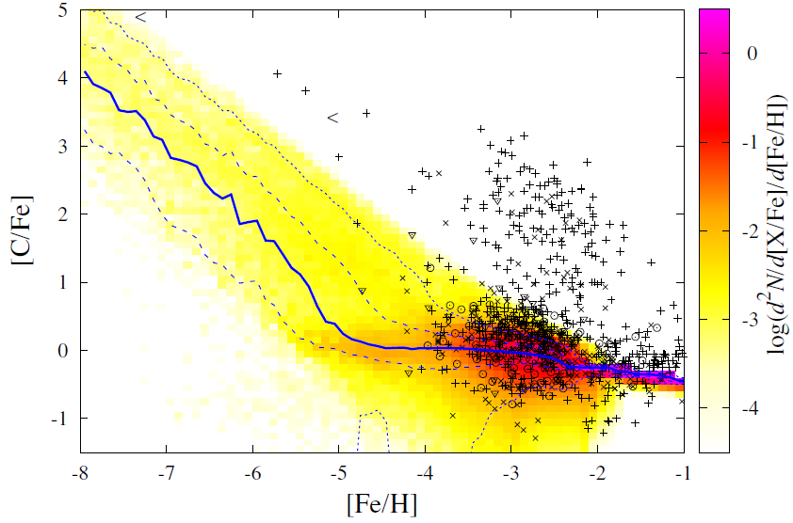
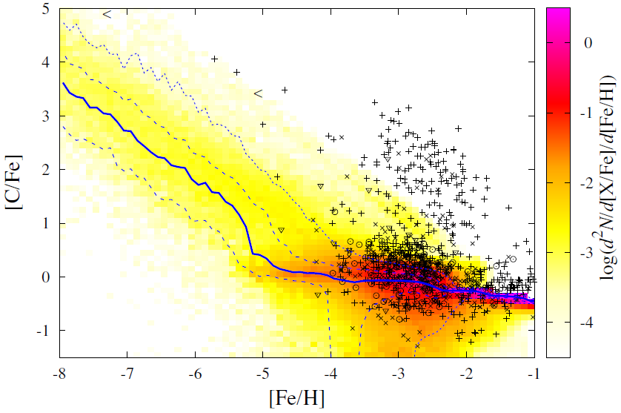
Metal mixing
[C/H]=-3
[C/H]=-2
[C/H]=-1
C_{diff} = 10⁻⁷ yr ^{-3/2} M_{sun}
E = 10⁵¹ erg
C_{diff} = 10⁻⁷ yr ^{-3/2} M_{sun}
E = 10⁵⁰ erg

Slide 14
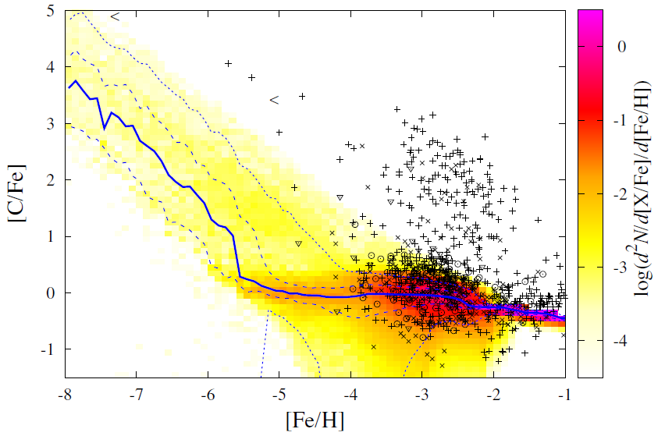
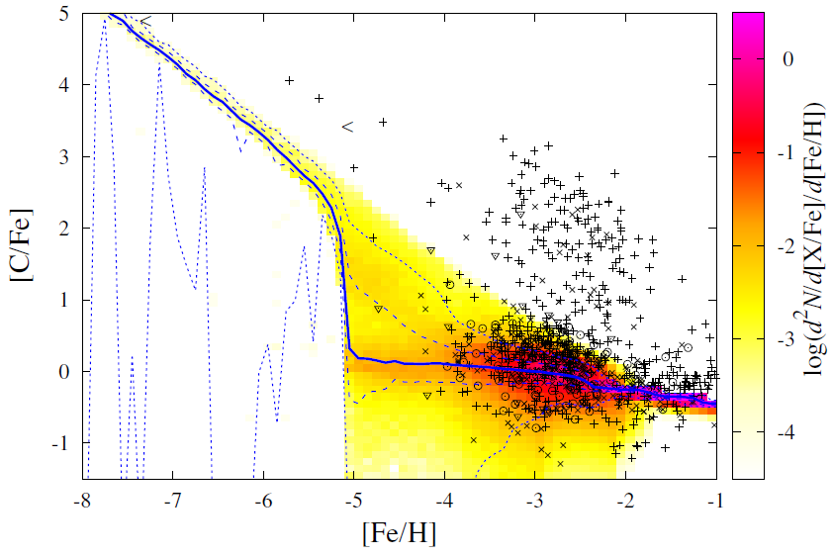
Pop III IMF
C_{diff} = 10⁻⁷ yr ^{-3/2} M_{sun}
E = 10⁵¹ erg
M_{md} = 100 M_{sun}
Low mass stars are formed only with
(Chiaki+ 2017)

Slide 15
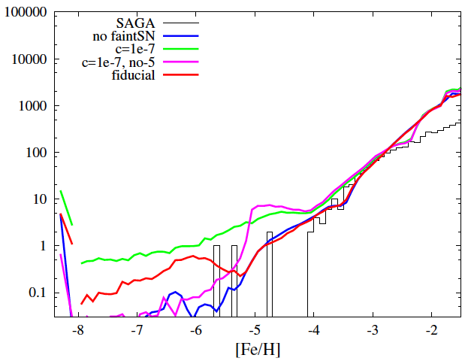
Metallicity distribution function
small C_{diff}
⇒ overproduction of UMP, HMP stars

Slide 16
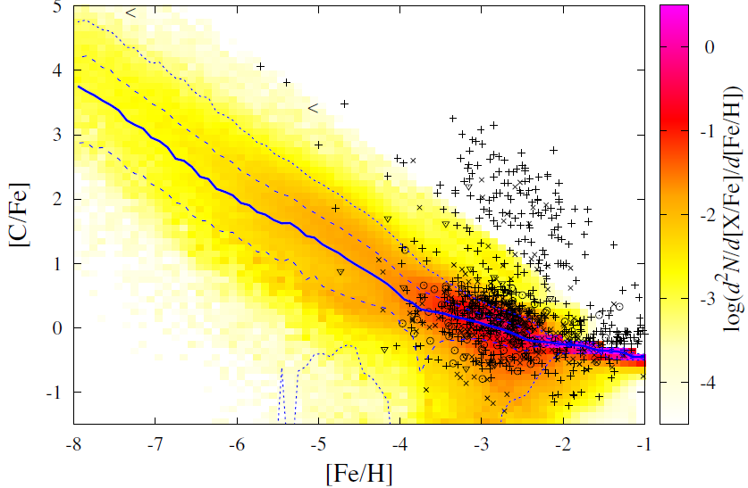
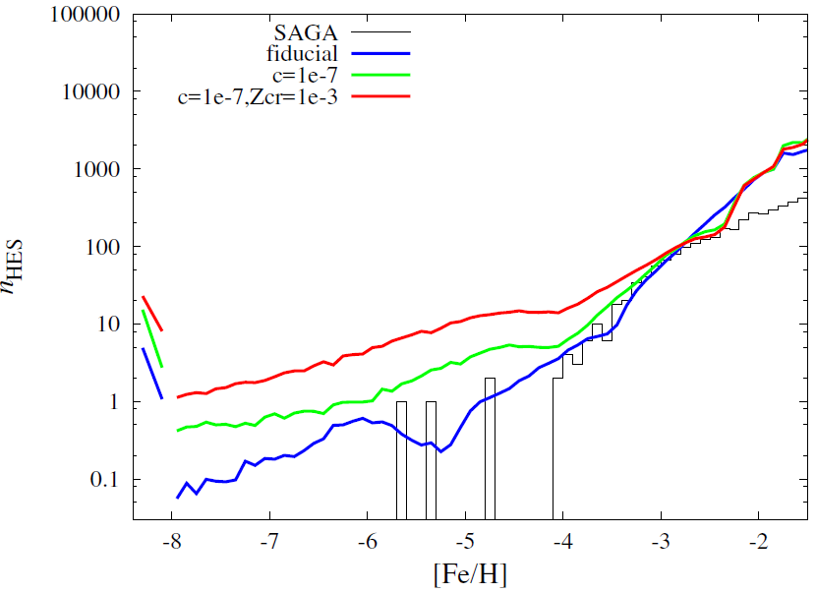
Z_{cr}
Z_{cr} = 10⁻³ Z_{sun}
C_{diff} = 10⁻⁷ yr ^{-3/2} M_{sun}
E = 10⁵⁰ erg
Majority of UMP stars are C-rich but overproduction of UMP/HMP stars

Slide 17
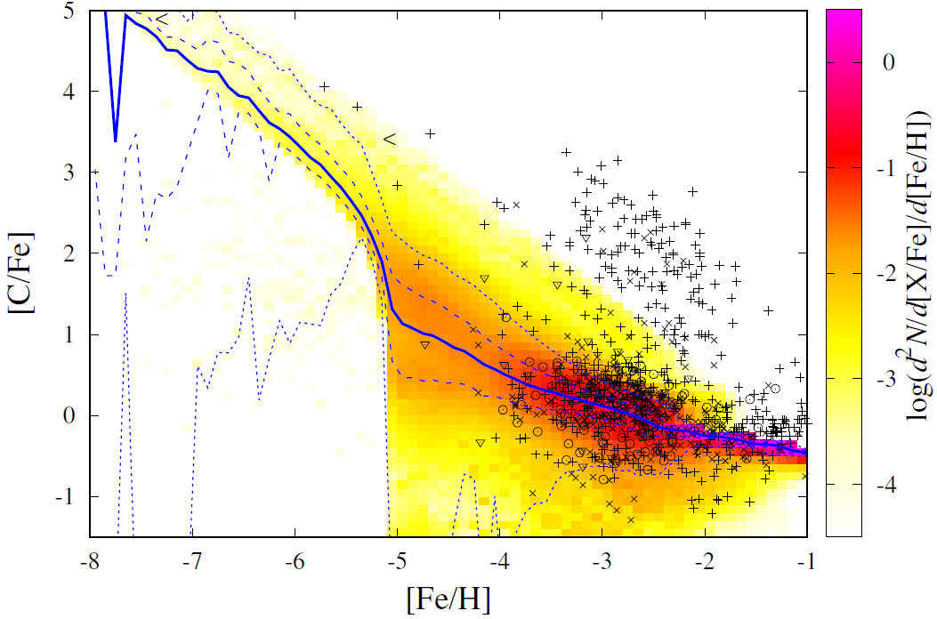
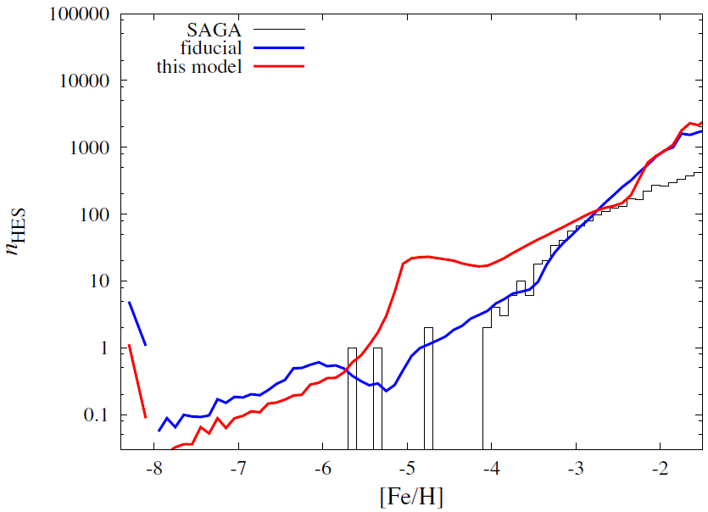
C_{diff} = 10⁻⁷ yr ^{-3/2} M_{sun}
E = 10⁵⁰ erg
Z_{cr} = 10⁻³ Z_{sun}

Slide 18
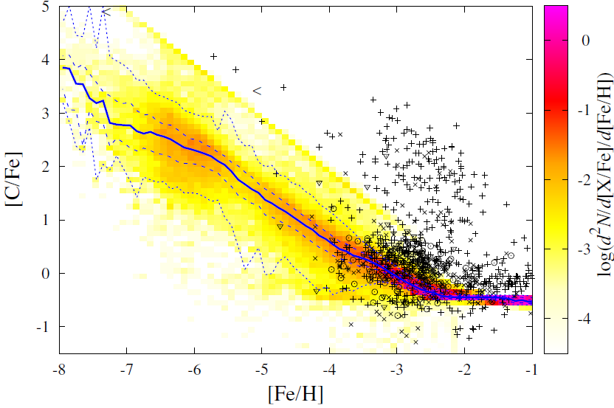
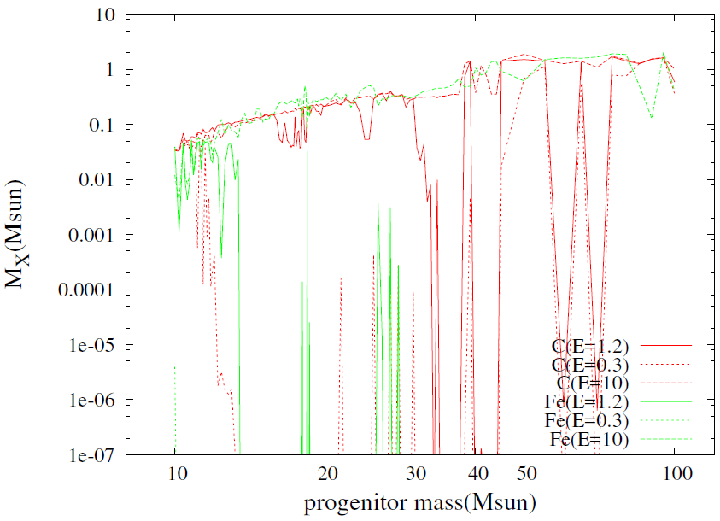
Heger & Woosley (2010)
大質量、低エネルギー だと、fallback する傾向
でも一概には言えない
重い方ではM_{C} > 1M_{sun}になるモデルも
E: random sampling from 0.3 ~ 10×10⁵¹erg
Z < Z_{cr} = 10⁻³ Z_{sun}: Heger & Woosley (2010) Z > Z_{cr} : Woosley & Weaver (1995)
C_{diff} = 10⁻⁵ yr ^{-3/2} M_{sun}
E = 10⁵¹ erg
M_{md} = 10 M_{sun}

Slide 19
Binary scenario
CEMP-s
CEMP-no
Hi-CEMP-no: Companion with M > 4M_{sun}
Lo-CEMP-no: Little mass-transfer
Stars without detection of V_{rad} variation ← wide separation
Fe:
[Fe/H] ~ -3: normal SN
[Fe/H] ≲ -4:
Surface pollution of Pop III stars
Pre-enrichment of mini-halo
Faint SN ?
Sr, Ba, Eu, Pb in CEMP-no stars (Fujimoto-san’s talk)

Slide 20
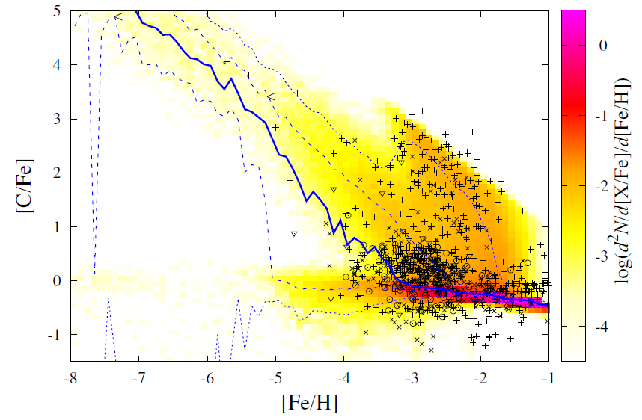
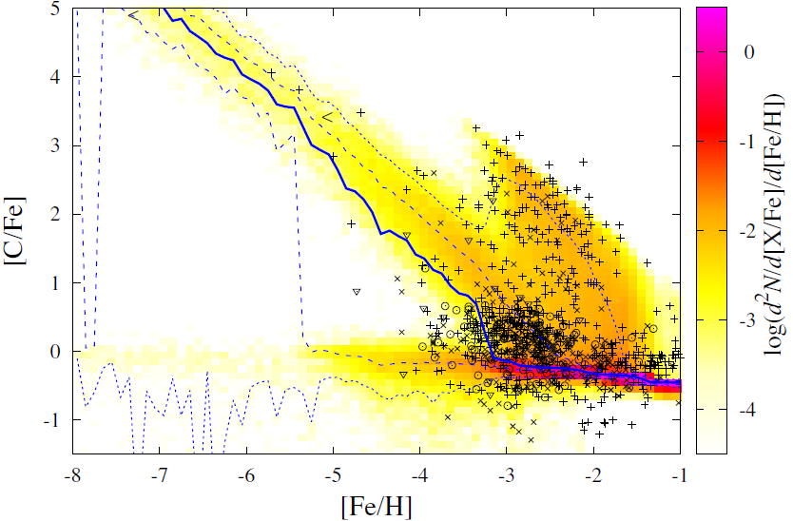
Result (binary scenario)
All stars with [Z/H] < -3 are binaries.
Period distribution: P = 10^{4.5}days, σ = 0.5 (lognormal)
[Z/H] > -3: P = 10^{4.8}days, σ = 2.3 (Duquennoy & Mayer 1991)

Slide 21
“Missing UMP-s (HMP-s) problem”
Separation distribution with the narrow peak
P = 10^{4.5}days, σ = 0.5
No CEMP-s stars at [Fe/H]<-3.5
No stars with large mass transfer from intermediate massive stars
Why ?
No binary ?
No intermediate mass stars ?
No C & Ba dredge up in intermediate massive stars ?
Separation distribution
Small mass loss rate
Binary scenario with the restricted separation distribution explains
Most of UMP stars have [C/H]~ -1.5
No UMP-s star
Norris+ 2013

Slide 22
Summary
Do CEMP no stars originate from faint SN?
Chemical evolution with faint SN
Group II: OK
Group III: difficult to be [C/H] > -2
Small mixing mass ⇒ overproduction of UMP
Group I: [C/H] is much higher
Majority of UMP star are C normal
HMP star, UMP star
Faint SN scenario does NOT explains that most of the UMP stars are C-rich
Low mass star formation criterion ? (Chiaki+ 2017)
There should be also normal SN at [Fe/H]<-4
MDF, C-normal UMP stars
Binary scenario
[C/Fe] increase without change of [Fe/H]
P ~ 10^{4.5} day, σ = 0.5
Spinstar ?
Faint supernova も
問題あり
（少なくとも、かなり fine tuning が必要）

